Slide 1
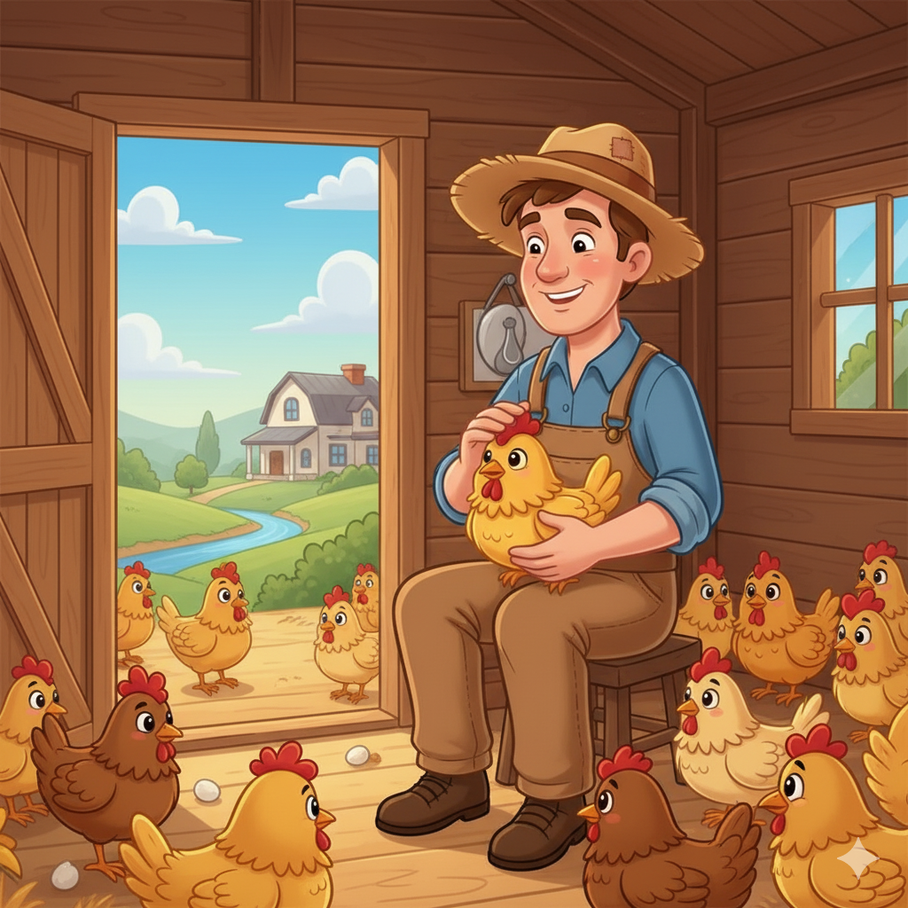
Goldie is the best hen in the whole world. I'm so lucky to have such a faithful little friend

Slide 2
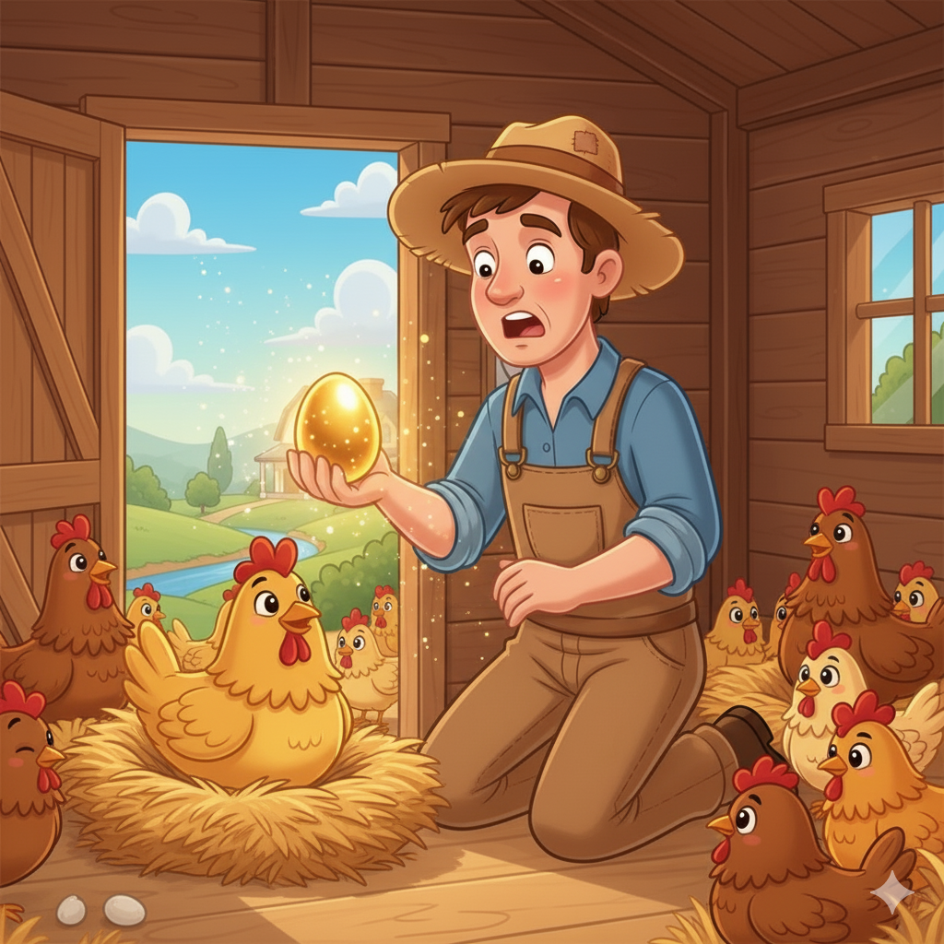
A golden egg?! I must be dreaming! This little hen is a miracle!"

Slide 3
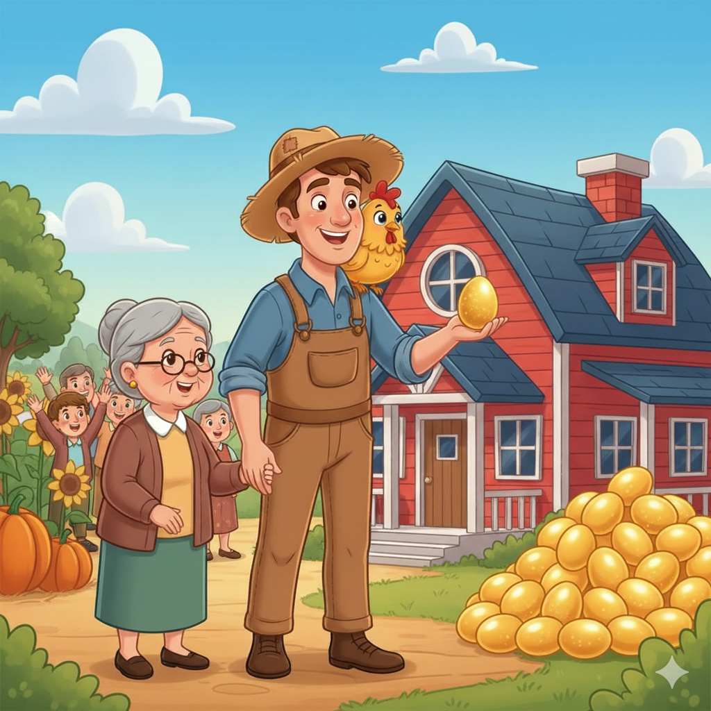
With one egg a day, I can fix the farm, help the village, and live a comfortable life. I am truly blessed.

Slide 4
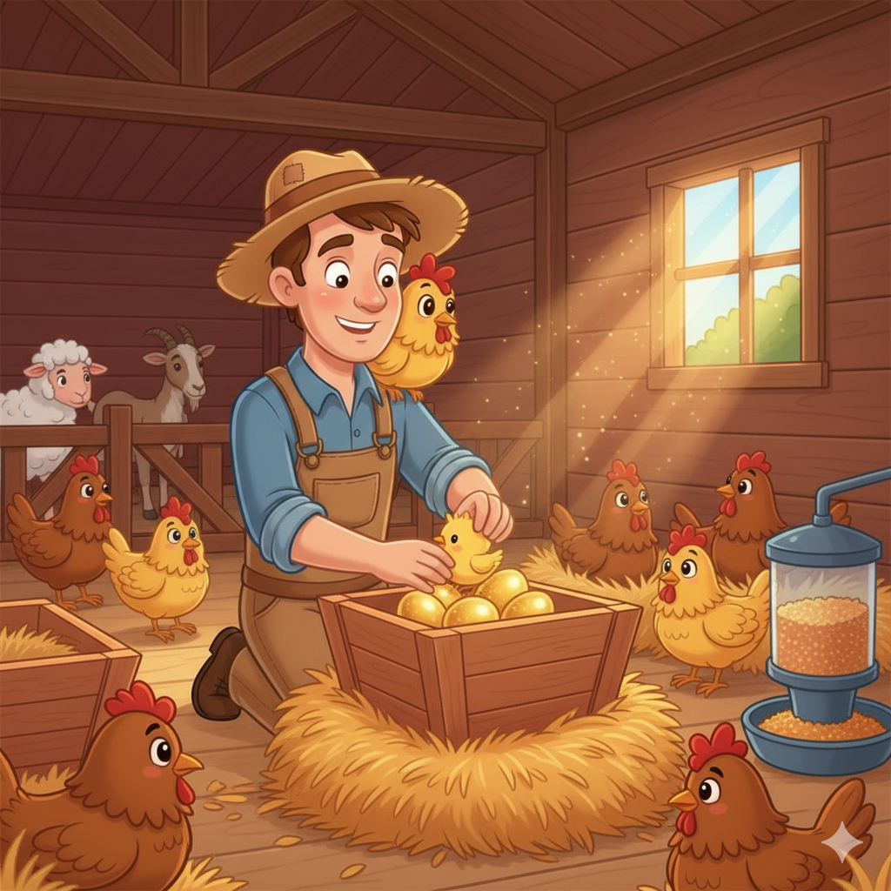
Wait, I get one egg a day... but what if there are hundreds inside her? I could be rich instantly! Why wait?

Slide 5
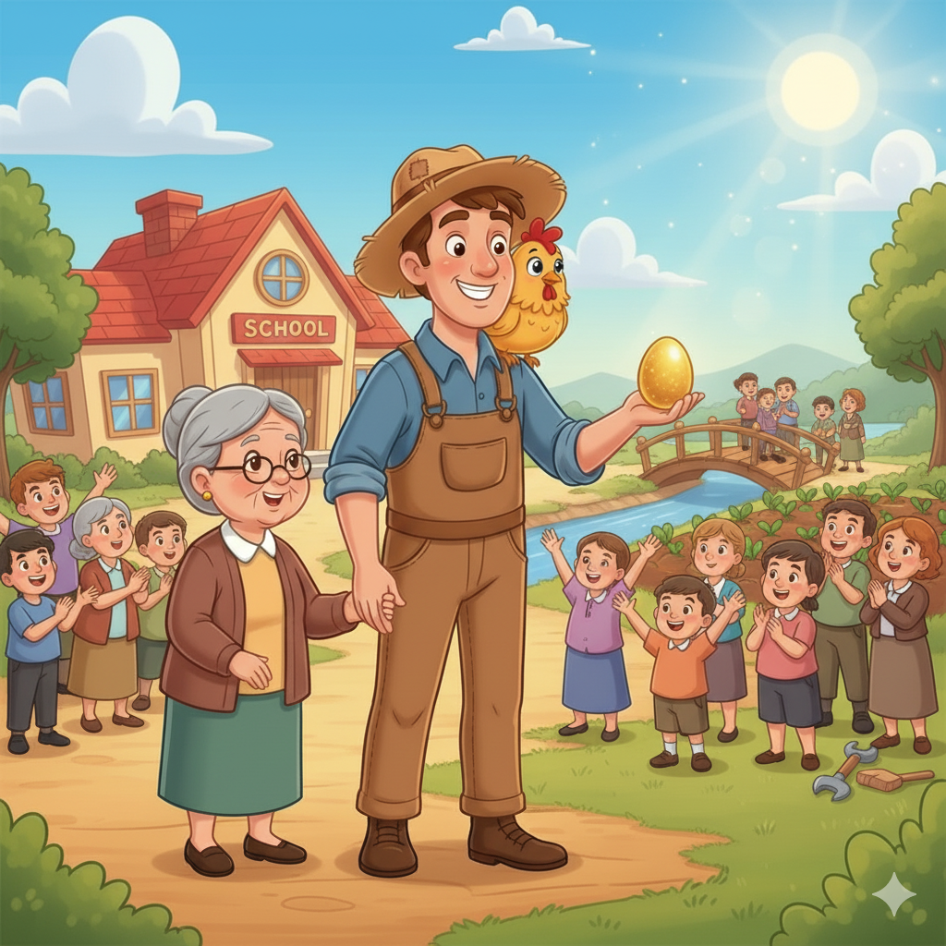
Oh, what have I done?! My greed... I ruined everything! I lost Goldie and all her daily magic for a foolish, selfish thought.

Slide 6
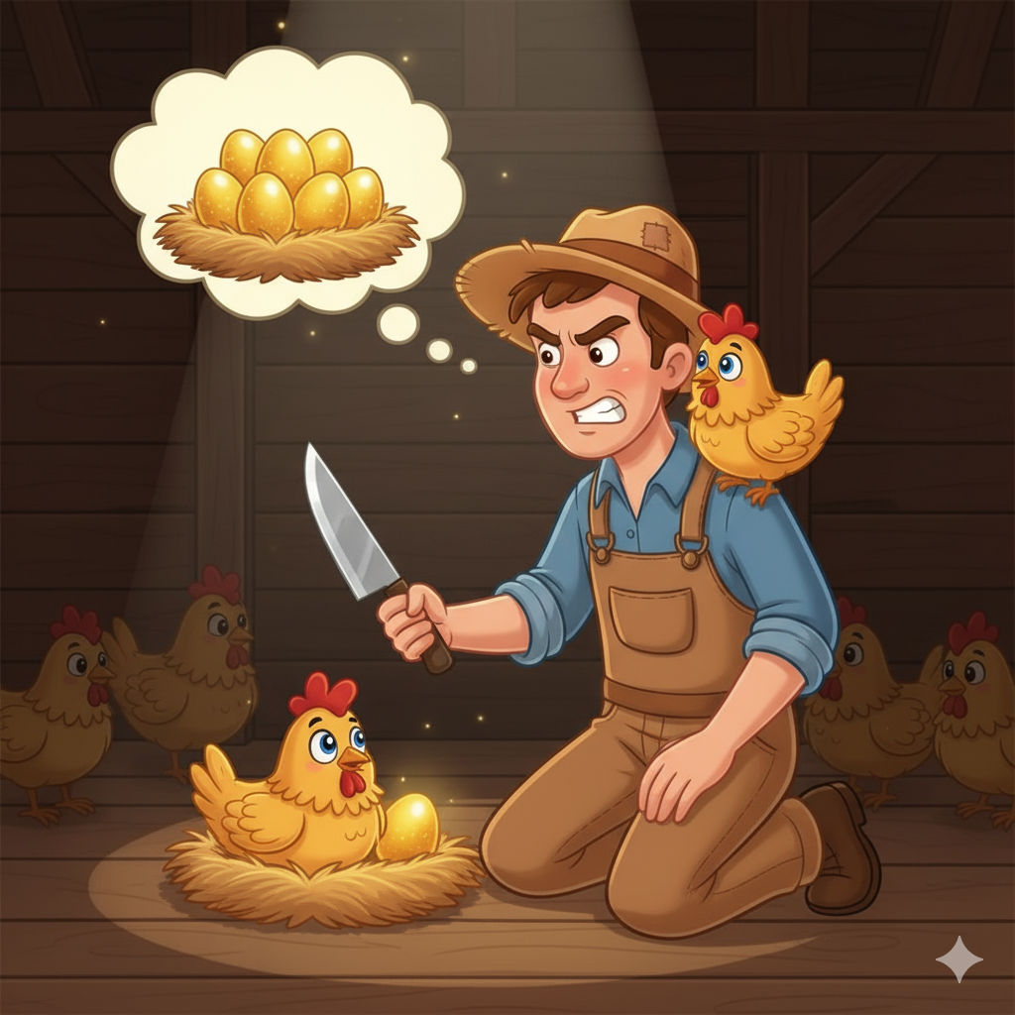
It feels good to help people... but this gold is running out faster than I thought. I need more, and I need it now.

Slide 7
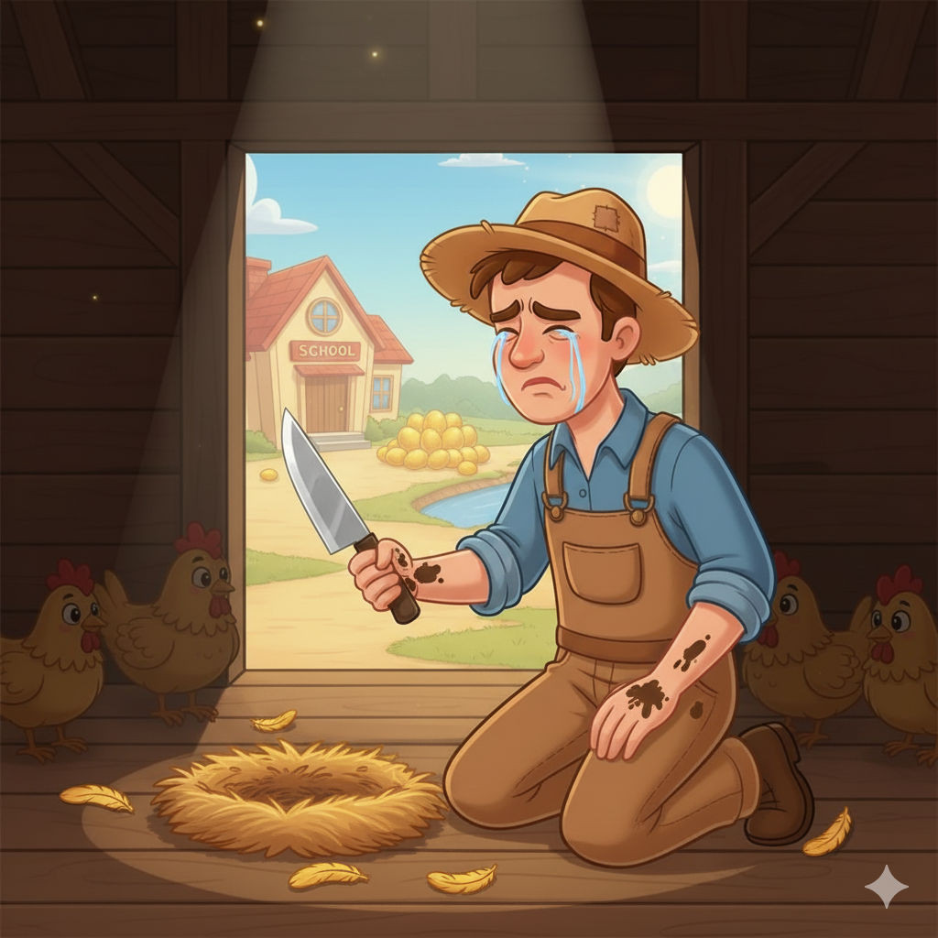
I was so happy with what I had. Now, the eggs will stop, and my happiness is gone. Greed took everything.

